Slide 1
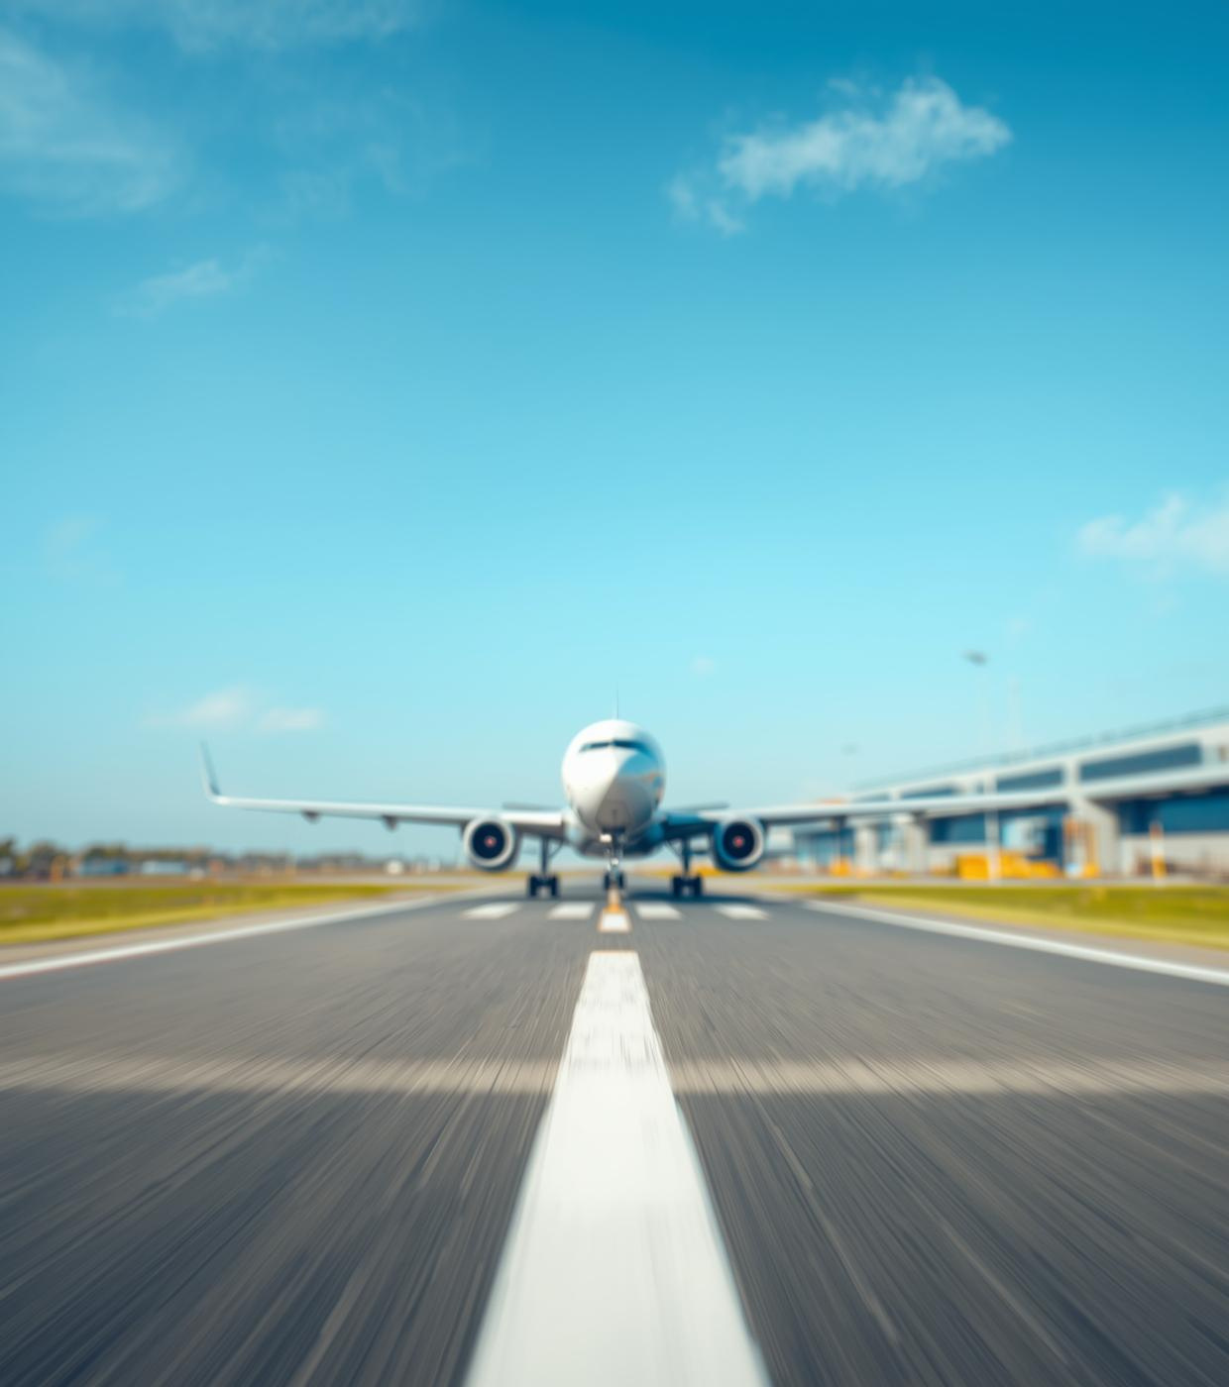
DATA 5300: United Airlines Delays
An Analysis of Departure Patterns in 2013
Presented by Dan Nguyen, Jennifer Poling, Paul Skentzos
Notes:
introductions, course (DATA 5300), and purpose: to explore what factors contributed to United Airlines delays in 2013.

Slide 2
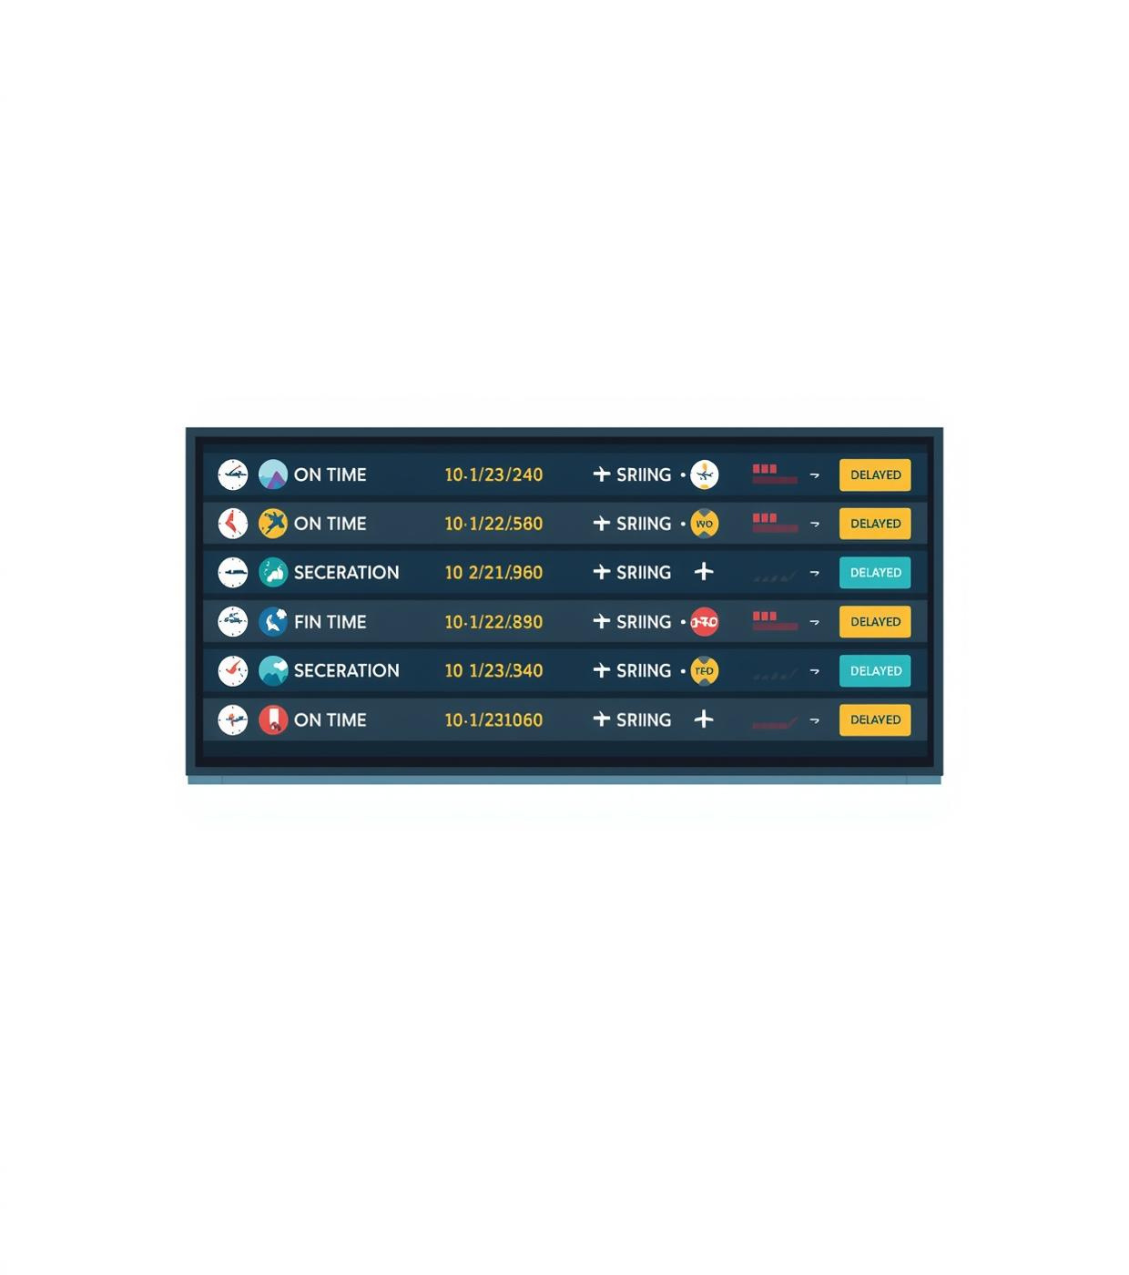
Why Study Delays?
Understanding the impact of flight delays on efficiency and traveler satisfaction
Delays affect efficiency and customer satisfaction
Understanding causes improves operational reliability
Data-driven insights reduce costs and traveler frustration
Notes:
Explain why delays matter, efficiency, cost, and customer frustration, and that this motivates data-driven analysis.

Slide 3
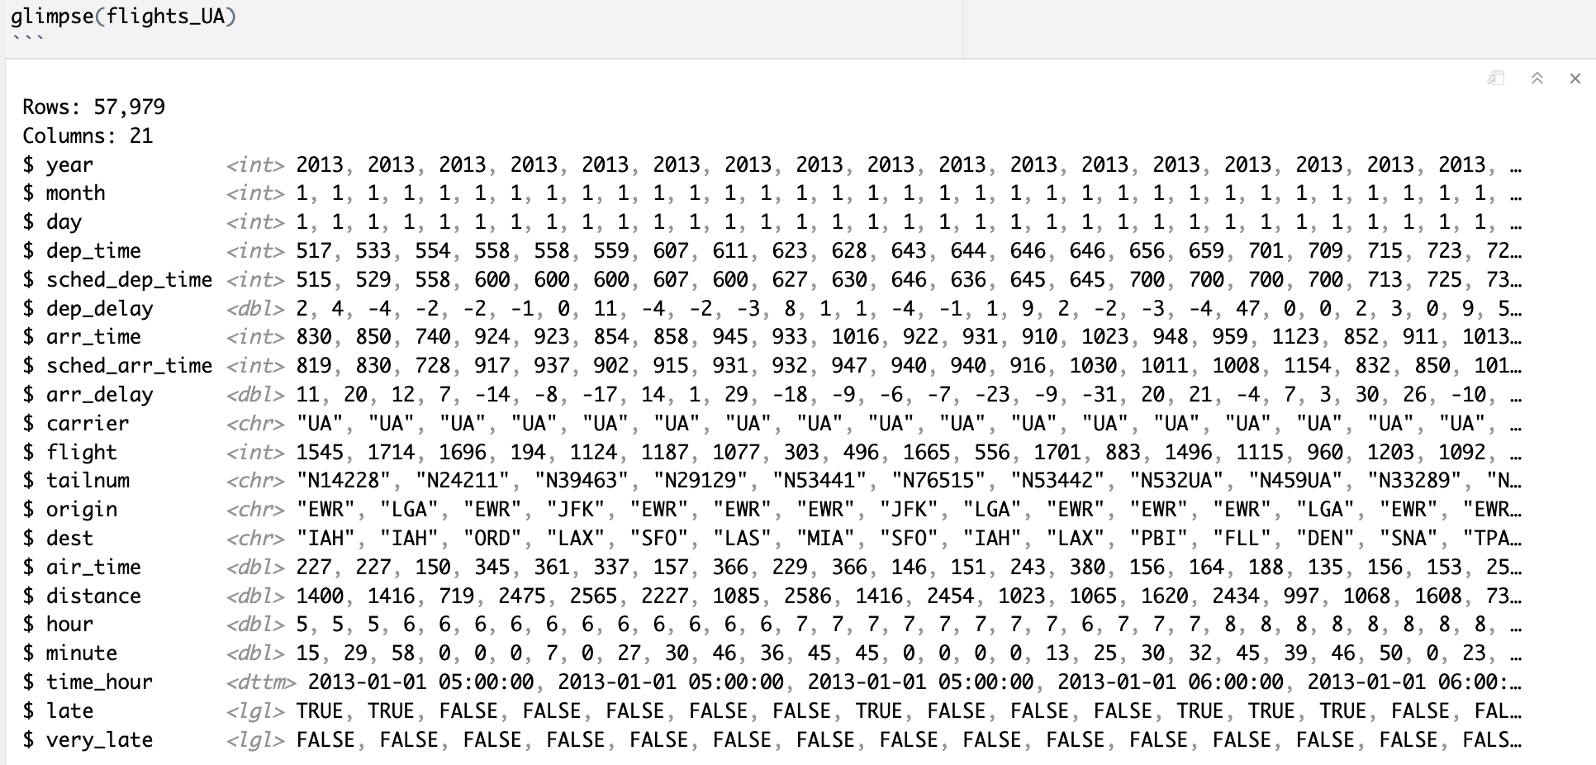
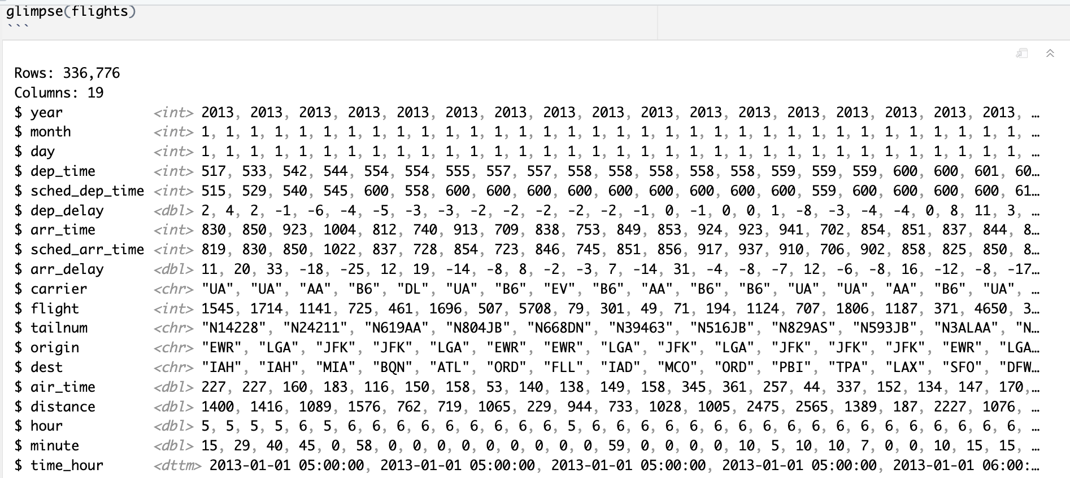
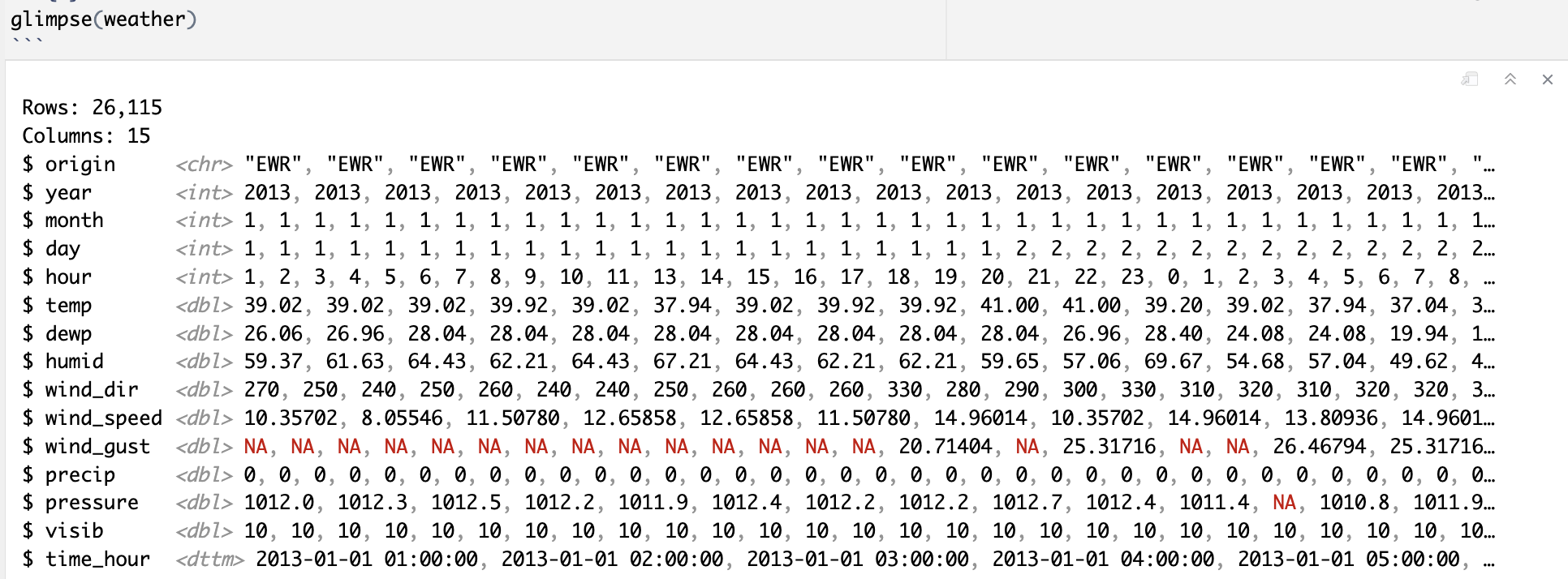
Data and Methodology
Dataset
Utilized nycflights13 data for United Airlines flights.
Weather Integration
Combined flight data with hourly weather observations.
Delay Labels
Created labels for 'late' and 'very late' flights.
Notes:
Describe datasets (flights + weather), 57 k UA flights, and how the “late” and “very late” labels and categories were created.

Slide 4
Statistical Approach
EDA
Exploratory Data Analysis reveals trends and patterns effectively.
Permutation Tests
Non-parametric tests assess the significance of observed differences.
Notes:
We used exploratory plots and permutation tests only. There were no parametric tests ran. Explain permutation briefly: shuffle labels to test if patterns are due to chance.

Slide 5
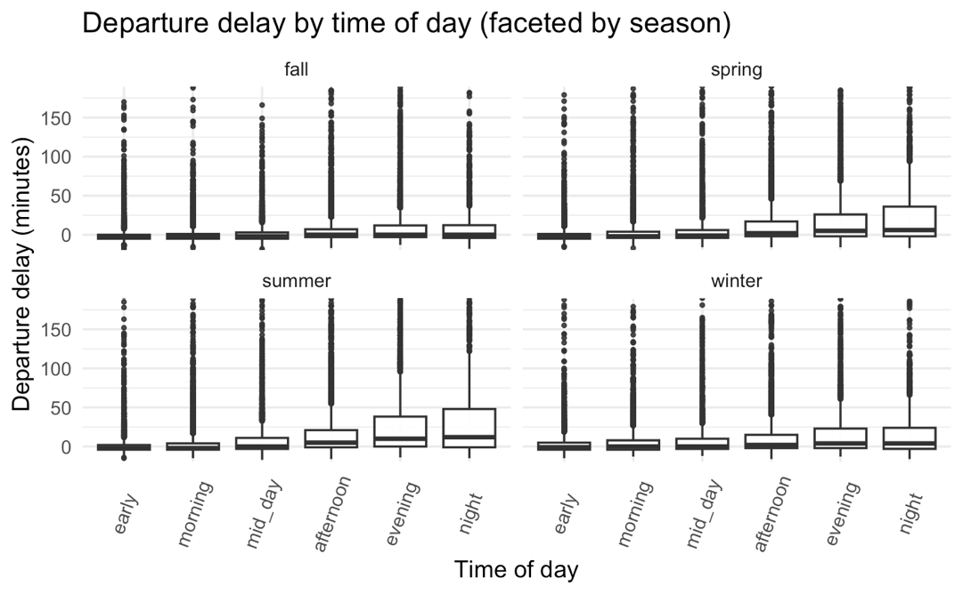
58%
Late Flights
Delays are predominantly influenced by the time of day, with 58% of late flights occurring during evening hours. This pattern highlights the need for better scheduling during peak times to enhance efficiency.
Notes:
Describe pattern: delays lowest early morning, peak evening/night, highest in summer. Mention permutation test p = 0.0001 (statistically significant).

Slide 6
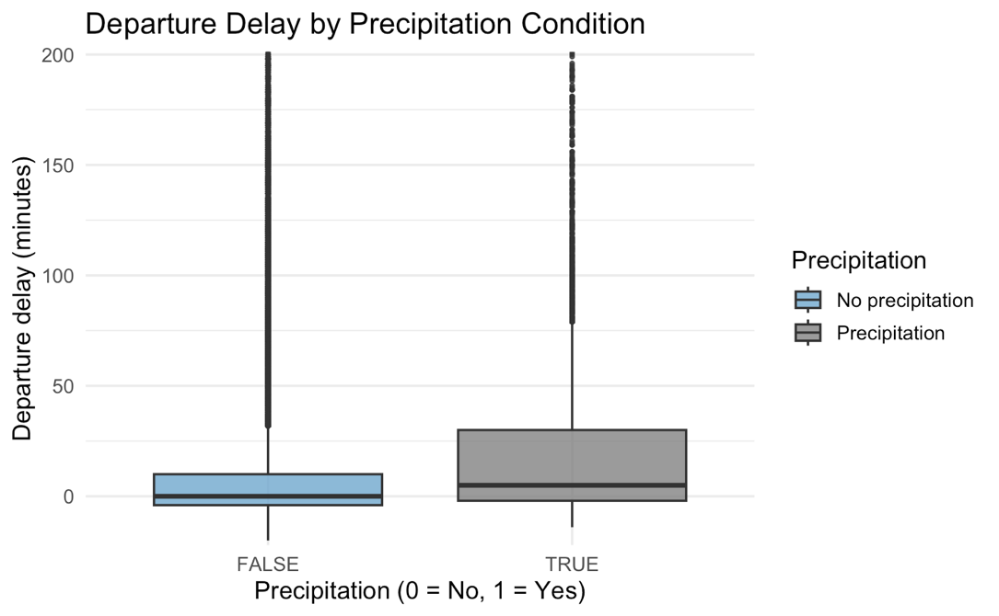
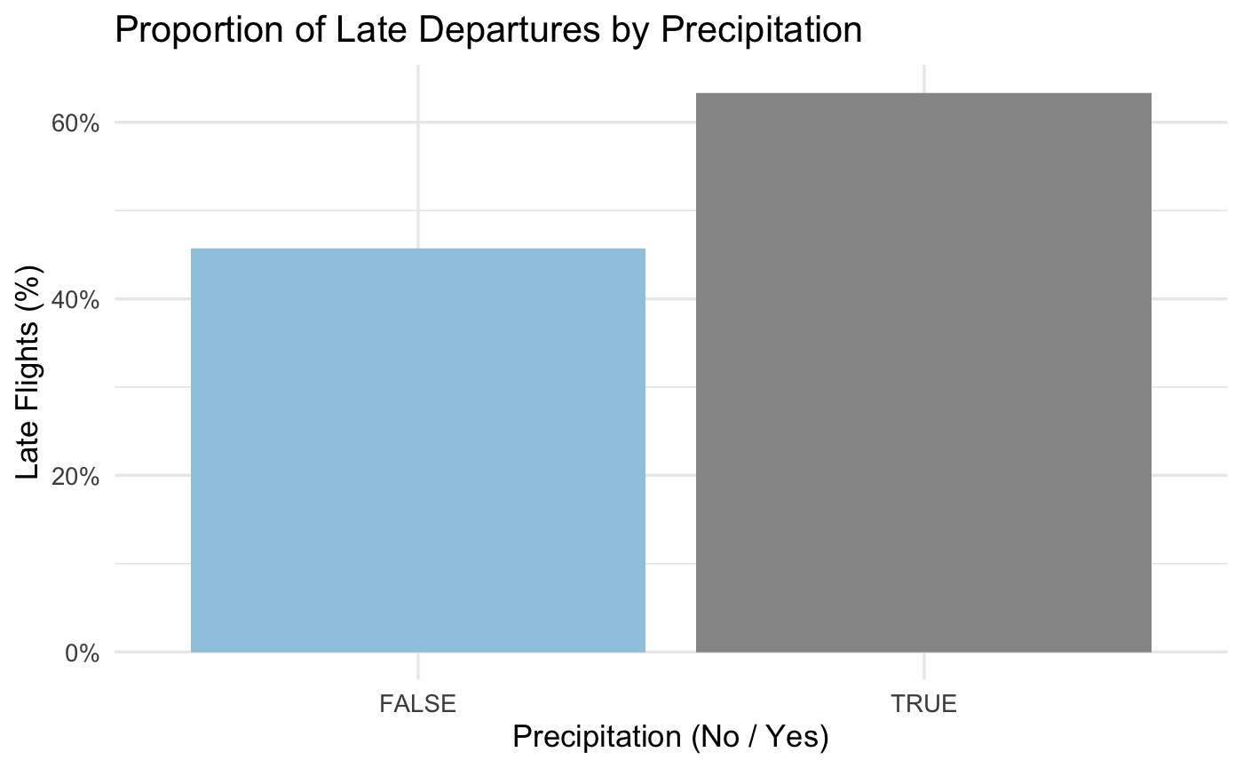
75%
Delay Rate
Flights experiencing precipitation have a significantly higher delay rate of 75%, highlighting the adverse impact of weather conditions on timely departures. This statistic underscores the need for enhanced weather responsiveness in airline operations.
Notes:
Note that flights with precipitation have much higher late-flight rates; explain that the difference is highly significant (p = 0.0001).

Slide 7
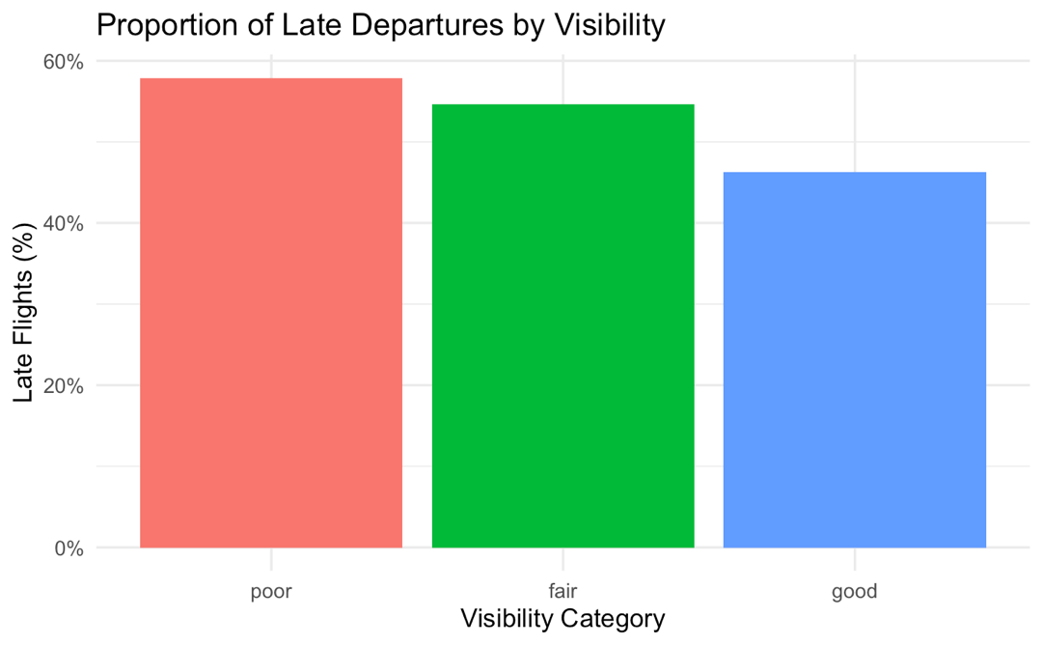
58%
Late Flights
Flights operating in poor visibility conditions, defined as less than 3 miles, experienced a significantly higher late arrival rate of 58%, highlighting the challenges posed by weather on flight schedules.
Notes:
Point out clear gradient: 58 % late under poor visibility vs 46 % under good. Visibility strongly affects delay likelihood (p = 0.0001).

Slide 8
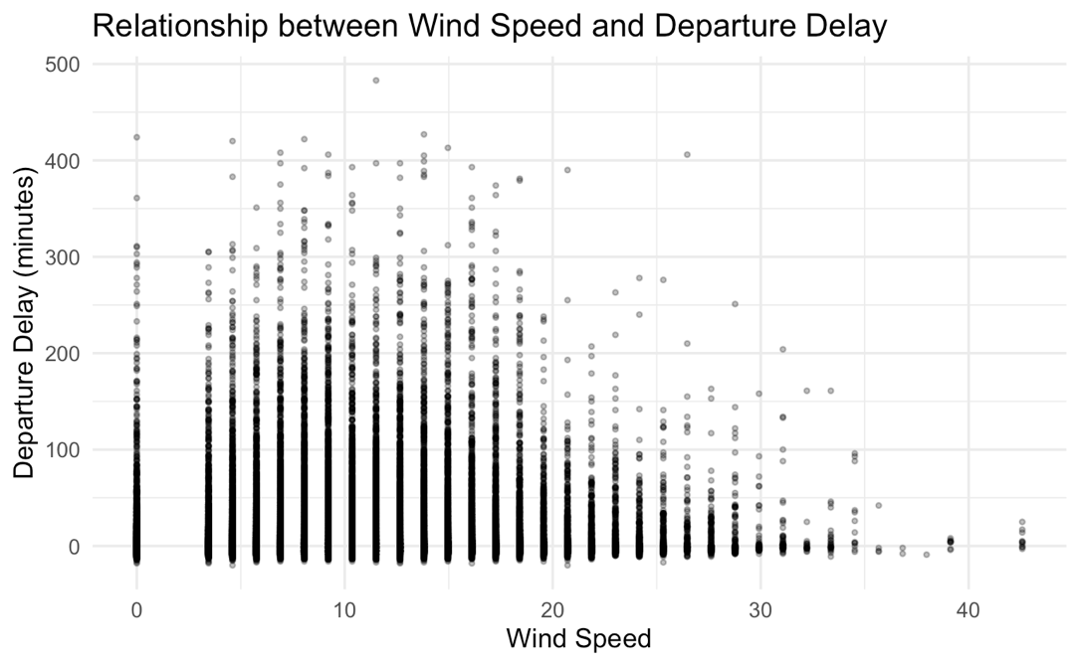
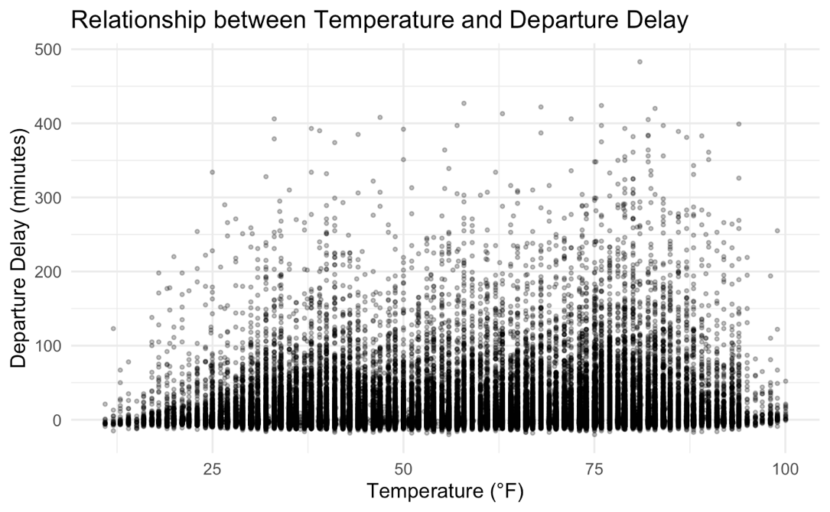
15%
Minor Effects
The analysis revealed that temperature and wind speed have detectable effects on flight delays, but these relationships are modest compared to the influence of time of day and weather conditions.
Notes:
Mention that while statistically detectable, temperature/wind effects are small in practice (aircraft handle wide ranges).

Slide 9
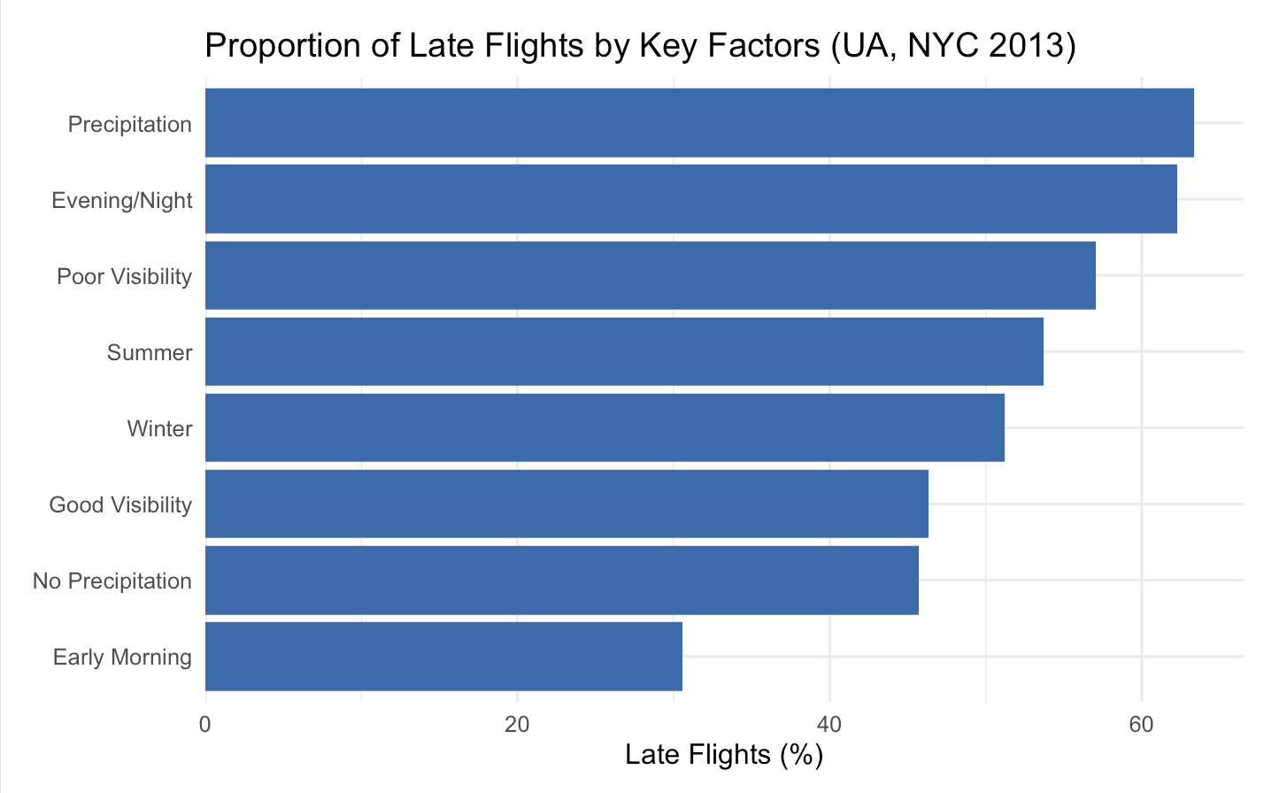
Key Insights
Summary of Findings on United Airlines Departure Delay Patterns
Time of day is the strongest predictor of delays
Weather factors significantly influence flight performance
Temperature and wind effects are minimal in comparison
Notes:
Summarize: time of day + season = strongest; precipitation + visibility = weather factors that matter; temp/wind = minor.

Slide 10
Future Research Directions
Understanding the implications of evening delays is crucial for improving overall airline efficiency.
Investigate potential cascading effects on subsequent flights.
Analyze how delays impact customer satisfaction and operational costs.
Explore seasonal trends to enhance resource allocation during peak times.
Future work should also focus on network-wide effects, examining how delays at one airport affect the entire system. This could involve:
Utilizing multi-year data to identify patterns and make predictive models.
Collaborating with other airlines to enhance operational strategies.
Implementing advanced analytics to optimize scheduling and minimize delays during adverse weather conditions.
By addressing these areas, airlines can improve their service reliability and ultimately enhance traveler experiences.
Notes:
Discuss why evening delays likely cascade from earlier ones and note that next steps include analyzing multi-year or multi-airline data.

